Slide 1
Use Case diagram
By Dale Smallwood

Slide 2
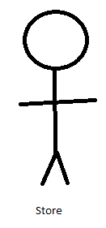
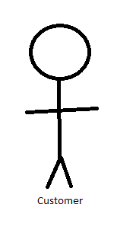
Online store
Login
Verification Login
<<include>>
Add item to basket
<<extend>>
Login Error
Order
Verify funds
<<include>>
Payment
Cash
Card
Sign up

